Slide 1
Otitis media

Slide 2
Terminology
Otitis Media: inflammation of the middle ear cleft or mucosa.
Acute → Less than 6 weeks
Chronic → More than 6 weeks
Recurrent acute otitis media → 3 episodes/6 months or 4 or more episodes/1 year
Otitis media with effusion: fluid in the middle ear without signs or symptoms of infection.

Slide 3
Middle ear cleft contains:
Middle ear cavity
Eustachian tube
Mastoid antrum
Mastoid air cells
Aditus
Atic

Slide 4
Otitis media with effusion (OME)
Accumulation of fluid in the middle ear
Following an episode of Otitis media
It is not necessary to have a prior episode of acute OM.
Middle ear effusion → short-lived & resolves completely no need for treatment.
OME / glue ear → fluid persists with an intact ear drum (no perforation) 3 months or more.
  Affects most children at one time or another in up to 1/3
  Persist for 3 months or more
  Commoner in winter & small children
  Cause significant deafness if left untreated
  May result in permanent middle-ear changes.

Slide 5
Etiology
AOM (most imp)
Adenoid
Allergic rhinitis
Cleft palate
Down syndrome
Passive smoker
Early exposure to pathogens
Pt’s with mucociliary disorder

Slide 6
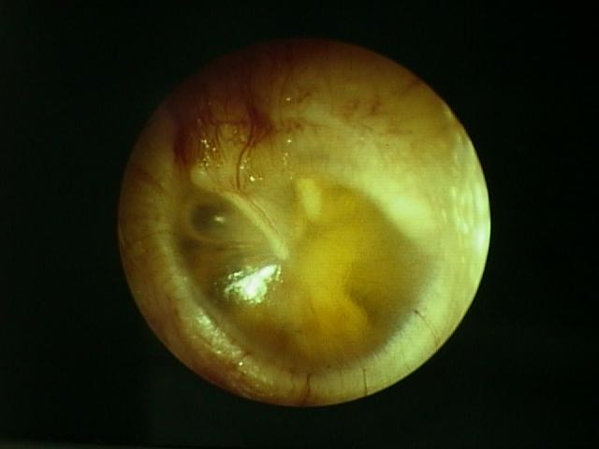
Symptoms:
Conductive deafness
Discomfort but not pain
Sometimes tinnitus.
Signs:
Otoscope: Dull yellow fluid behind the ear drum
Audiogram: flat curve

Slide 7
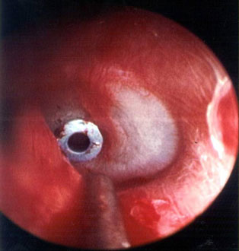
Management
Improve spontaneously
Treat predisposing condition (allergic rhinitis or cleft palate)
Myringostomy & grommet tube
  Puncture of the drum
  Aspiration of the fluid
  Insertion of a small tube (grommet) in the eardrum done under general anesthesia.

Slide 8
OME in adults
My follow
  URTI
  Sudden change in pressure (deep sea diving or a rapid descent from an aircraft).
Improvement is spontaneous & gradual my take up to 6wks.
Rarely a presentation of nasopharyngeal malignancy.

Slide 9
Chronic otitis media

Slide 10
Chronic otitis media
Inflammation of the middle ear
To be called chronic it needs to last for more than 6 weeks.
Usually preceded by an acute infection either acute ottits media or a viral URTI
The most common age for chronic ottits media is between the ages of 3-6 years old

Slide 11
Causes & predisposing factors
Late onset or inappropriate antibiotic treatment of AOM
URTI
Allergic rhinitis
Sinusitis
Adenoid hypertrophy
Lowered Resistance (malnutrition & anemia)
Short period breastfeeding
Long time group child care
Eustachian tube deformity
Nasal septum deviation
Cleft palate
Notes:
unusual growth ("hypertrophy") of the adenoid tonsil.

Slide 12
Symptoms
Conductive deafness
Vertigo
Tinnitus
Ear discharge (which maybe foul smelling when there is a cholestoma present)
Etiologies
P. aerugenosa
Proteus
E.coli
H. influenza

Slide 13
Classification
Chronic otitis media
Suppurative
(+ perforation)
Atico-Antral type
with cholestoma)(
Tubo-tympanic type
(without cholestoma)
Non suppurative
Ottitis media wth effsion or serous

Slide 14
Serous OME
The most common cause of serous OME is children is an enlarged adenoid
Stages:
URTI or acute otitis media that leads to Fluid collection in middle ear & obstruction of eutachian tube this leads to tympanic membrane retraction.
Fluid become pus and glue like and that leads to conductive hearing impairment & pain which eventually will end with necrosis and tympanic membrane perforation.
Could end up with mastoiditis (if untreated)
Management
Systemic decongestants
Nasal drops
Myringotomy (if the above 2 failed), tiny incision done in the ear drum to relief pressure and drain pus.

Slide 15
Tubo-tympanic otitis media
(Safe type without cholestoma)
Acute otitis media which leads to a permanent perforation that causes muco-purulent discharge.
Infection is limited to the mucosa (ant. Inf.)
With this type there is no risk of bone destruction
The perforation of the membrane is mostly directed centerally
Management
Clean the ear by syringing or hydrogen peroxide.
Local antibiotic (when the ear is totally clean and dry)
Surgery (if medical treatment failed)
  Myringoplasty: repair of tympanic membrane perforation & ossicles are intact (most used graft is autologous temporalis fascia)
  Tympanoplasty: repair of tympanic membrane & ossicles.

Slide 16
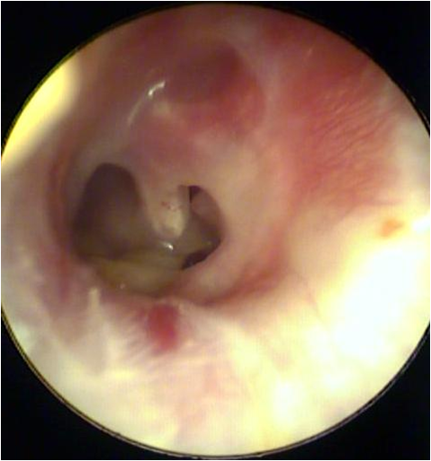
Perforation

Slide 17
Atico-antral chronic otitis media
(With cholestoma)
Life threatening (intra & extra cranial complications)
spreads by bone destruction (mastoid, tympanic ring, ossicles )
Perforation is posterio-superior
Discharge is usually persistent and often foul smelling.
There is granulation due to osteitis.
Aural polyps formed by granulation tissues
Associated with chlesteatoma:
Management:
Regular aural toilet in early cases of annular osteitis may be adequate to prevent progression.
Surgical removal of cholestetoma
Treatment of complications

Slide 18
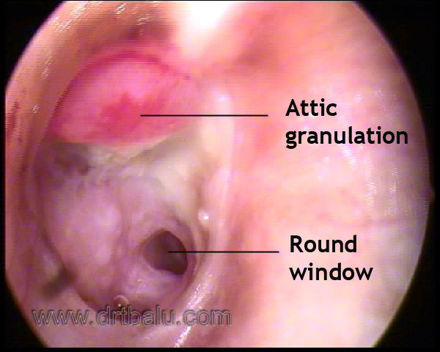

Slide 19
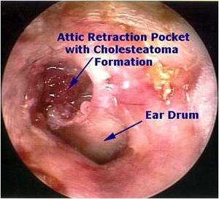

Slide 20
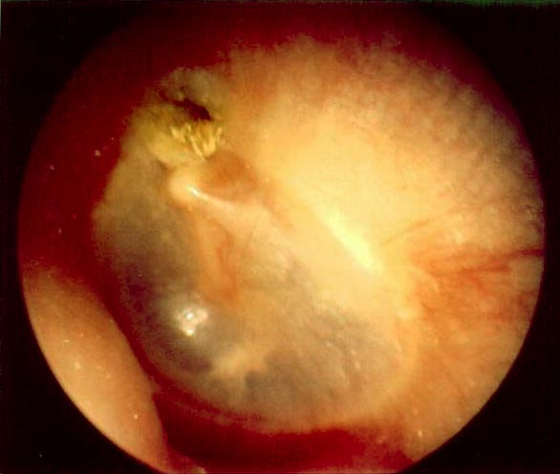
Cholesteatoma in the pars flaccida

Slide 21
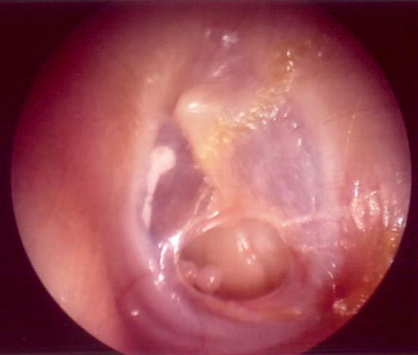
Central pars tensa tympanic membrane perforation with a healthy middle ear membrane.

Slide 22
How to differentiate between tubo-typmanic and attico-antral clinically
The first difference can be observed in discharge
The second difference can be observed in the position of the perforation itself
The third difference can be observed with the presence of a cholestatmoa
The fourth difference can be observed with severity of deafness

Slide 23
Cholesteatoma
Epithelial cells collection in the middle ear cleft basically an epidermoid cyst.
Produces mass effect on the structures that are present in the cleft
Treatment is by surgical excison
Why does bone erosion happen in chronic otitis media?
Pressure theory
Enzymatic theory (acid phosphatase, collagenase &other proteolytic enzymes) which are present in the cholestatoma
Pyogenic osteitis (Pyogneic bacteria may release enzymes)

Slide 24
